Slide 1
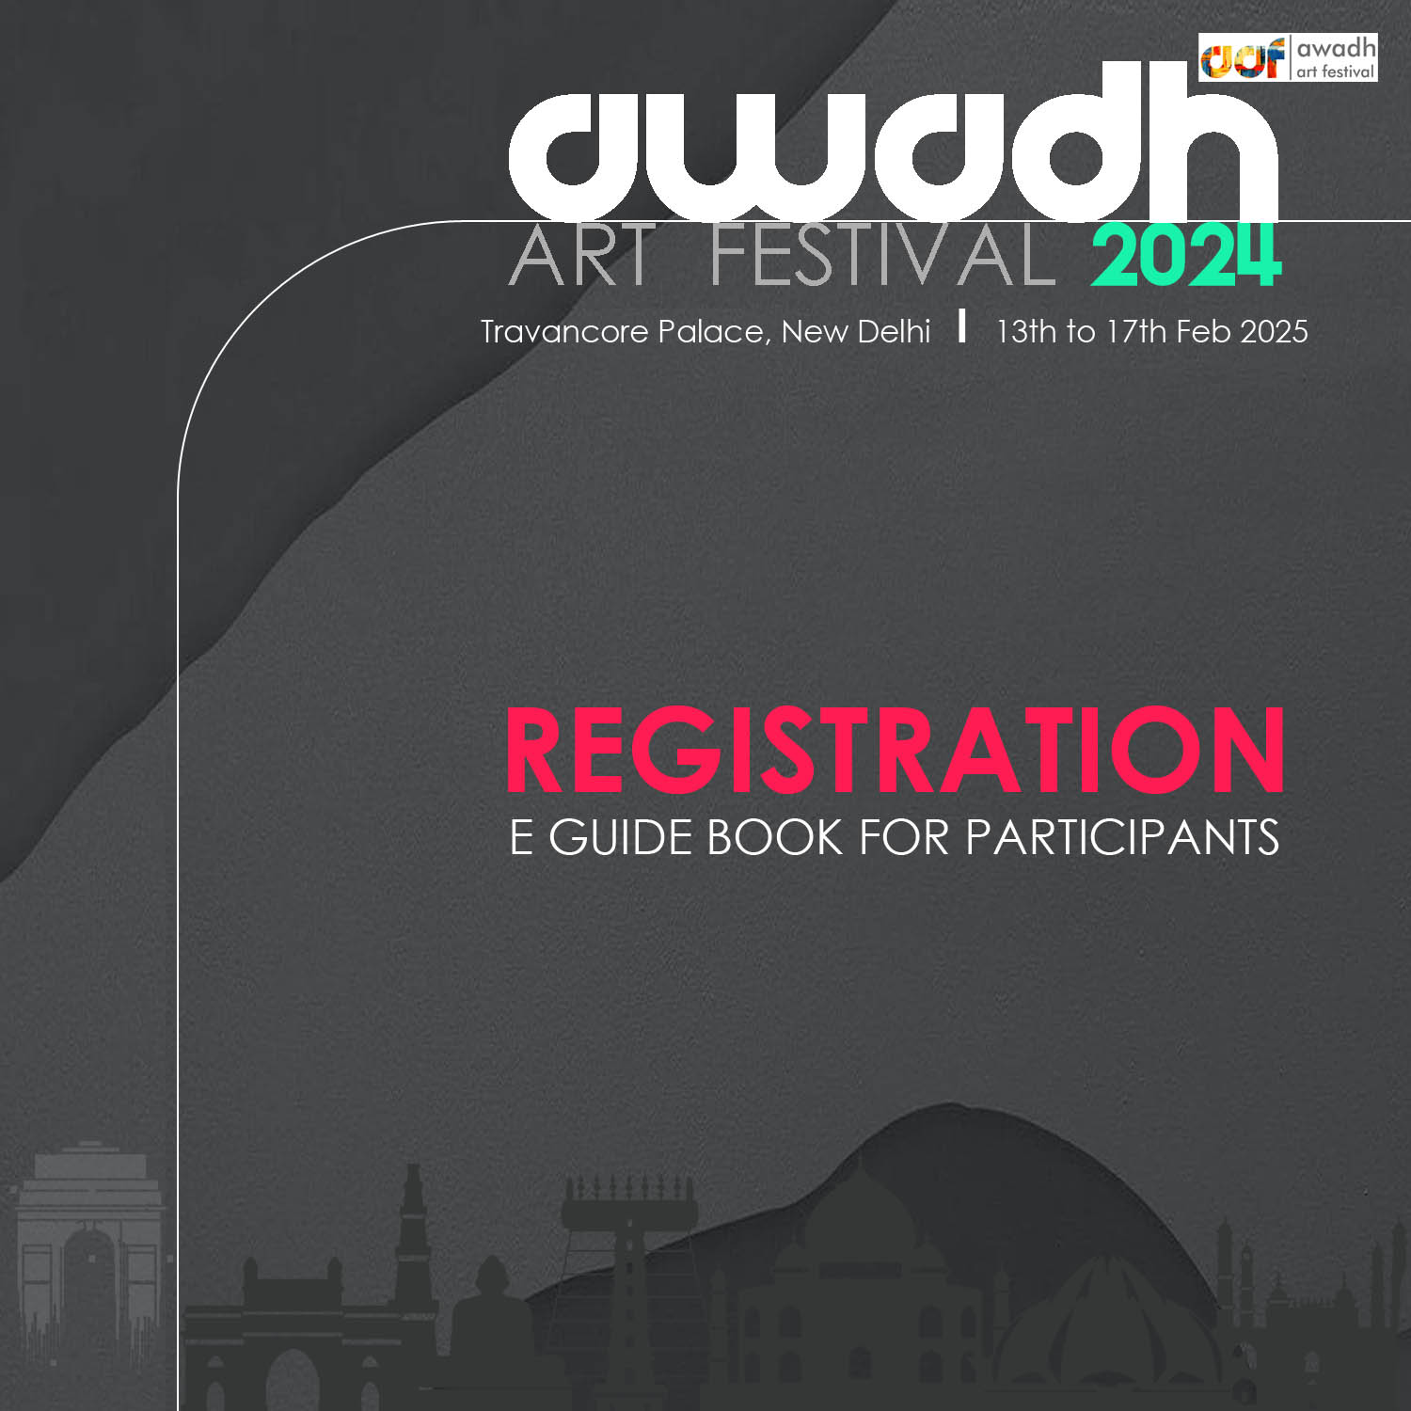

Slide 2

Awadh Art Festival is an art movement and an annual celebration of the arts that brings together a diverse community of artists and art enthusiasts from India and overseas. This event aims to be a marker of the power of human creativity and a platform for good artists who are the unsung heroes to showcase their talent, share their stories, and connect with a bigger and broader audience.
It has been 7 years now that we have been in the art market. Our journey began in 2018 with a passion for creativity and a vision to celebrate and promote the arts. Over these seven years, we've evolved, grown, and forged meaningful connections within the art community and beyond.
Our commitment to excellence remains unwavering. We will continue to uphold the highest standards of art curation, promotion, and community engagement. Quality, creativity, and authenticity will always be at the heart of everything we do.
This year AAF is committed to contributing to the fight against cancer. Thus we joined hands with Cancer Paitents Aid Association (CPAA). An organization that tirelessly aids those battling this devastating disease.

Slide 3

NAME OF FAIR : AWADH ART FESTIVAL
EDITION : 7th Edition
EXHIBITION DATE : 13th to 17th February 2025
VENUE : Travancore Palace
K. G. Marg, New Delhi
CATEGORIES : Painting, Sculpture, Pottery,
Painting Genre : Contemporary, Abstract, Realistic, Modern, Mixed Media etc
SELECTION : Strictly Curated.
To get selected please WhatsApp your artworks to +91 9833839951
DISPLAY TYPE : Gallery Display
PARTICIPATION FEES : Rs. 11000/- (Rupees Eleven Thousand only)
Last Date of Registration : 31st December 2024
REGISTRATION & PAYMENT : Online (through link)
CONTACT FOR REGISTRATION : +91 9833839951 (CALL OR WHATSAPP)

Slide 4

Story Telling Storytelling by artists weaves visual narratives that captivate and inspire, turning each artwork into a unique experience.
Masters The inclusion of master artists as usual will inspire other artists ultimately enhancing the overall quality and impact of the event.
Warrior Artists These wonderful artists will raise awareness, inspire & convey a message of resilience, strength and the transformative power of art in the face of adversity.
Art Walk It provides a curated journey for deeper engagement with art, fostering understanding and appreciation. It encourages community interaction that helps in promoting artists.
Art Talk provides insights into the artists' creative processes, inspirations, and the meanings behind their works. It creates a deeper connection between the audience and art. Additionally, it engages conversations among artists, curators, and attendees.
Book Launch Ads immense value by Enhancing Context, Broadening reach, building community, Educational Value and Artist Promotion.

Slide 5

All those wishing to register must share their artworks on whatsapp
(+91 9833839951) for approval. Upon approval, they will receive a link to complete their registration.
CATEGORIES : Paintings, Sculptures, Pottery, Ceramics, Photography.
Each entry must be authentic, original work of the participating artist.
ART WORK SUBMISSION DETAILS:
Paintings and Sculptures can be of any medium.
TOTAL 2 Artworks per entry will be allowed depending on size.
Artworks should not be older than 2020.
Every artwork should bear a Title, Year, Dimension, Medium, Price and a Short Story / Concept Note.
PREFERRED SIZE OF PAINTINGS should not exceed 36 X 36 Inches OR the max width of the Art Work should not exceed 36 inches.
PREFERRED SIZE OF SCULPTURES / POTTERY should not exceed 24 inches X 24 inches and height not more than 36 inches.
Images of art works submitted for registration / catalogue should be of high resolution and in JPEG / PNG format only.
No commission will be charged on Art Sale
10% of Art Sale will be donated for the cause of cancer to CPAA In return a special certificate will be issued by CPAA in favour of the Artist.
4. PARTICIPATION FEES:
INDIA INR 11000.00 (Rupees Eleven Thousand only)
INTERNATIONAL EURO 200.00 (One Hundred & Fifty Euros only)
ARTISTS DOLLAR 200.00 (One Hundred & Fifty Euros only)
(Extra charges for international artists is for the return couriers )
Fees can be paid in two instalments.
No refund will be entertained after 2 days of payment.
Last Date of Registration – 31.12.2024

Slide 6

Space allotted for display will be final.
Being a CURATED Art Fair, it is not mandatory for exhibitors / participants to be present at the venue.
All deals & negotiations related to art sale will be handled by the organizer.
Exhibitors will not be allowed to obstruct the light or impede passages or disturb the displays of neighbouring exhibitors.
Exhibitors are not allowed to encroach on aisles or open space.
Exhibitor shall take utmost care NOT to damage floor or structure during display and dismantling. The cost of damage, if any, will have to be borne by the exhibitor immediately.
Artists would report with the artworks a day prior to the opening.
Artists would be allowed to collect artworks the day after the closing.
Artists needs to make arrangements for packing and couriering of artworks.
FOR ENQUIRY REGISTRATION +91 9833839951 (CALL OR WHATSAPP)

Slide 7
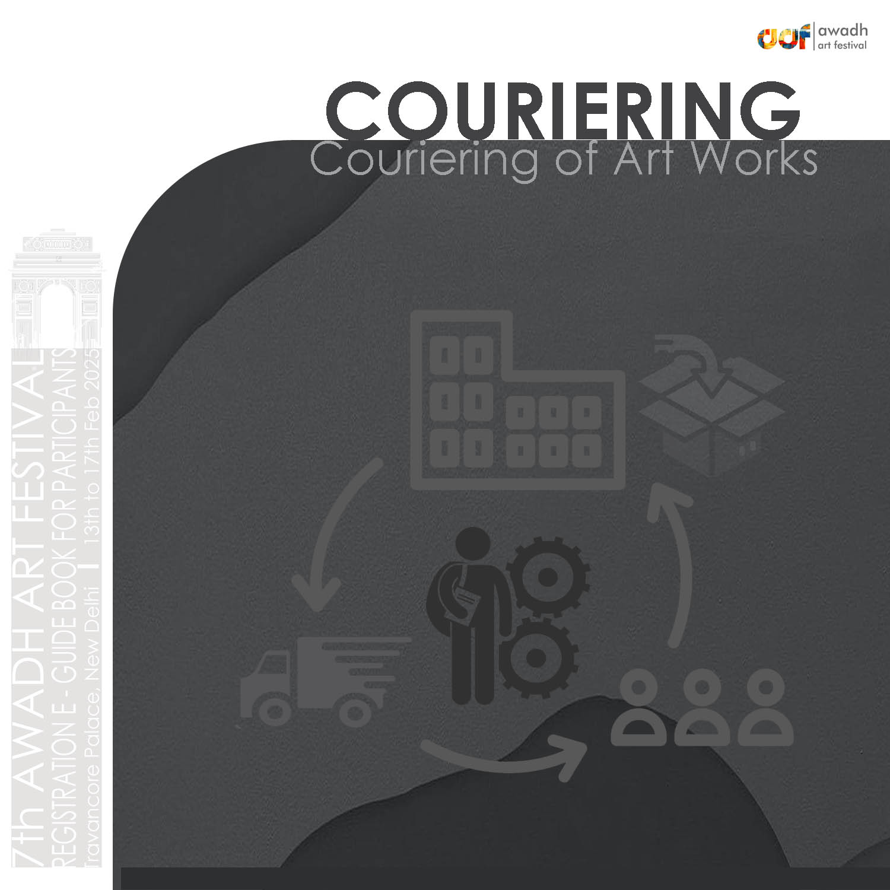
Art works / prints couriered from other states / countries should reach us between 1st to 10th February 2025 only
Art works may be couriered at the following Address:
C – 1, Gali No. 6,
Kikar Chowk,
Chander Vihar,
New Delhi – 110041 Ph : 9811076145 / 9910418480
Artworks that are couriered SHOULD NOT HAVE ANY GLASS COVERING instead fiber can be used.
Artworks that needs to be stretched / framed at the venue will be charged extra at actuals.
All artists must bear the costs associated with the packaging & transportation / courier of their art works to and from the exhibition venue.
All participants must collect their unsold works immediately after the exhibition concludes on the last day.
AAF takes no responsibility for accommodation. But we can help finding the best possible as per the participants.
FOR ENQUIRY REGISTRATION +91 9833839951 (CALL OR WHATSAPP)

Slide 8
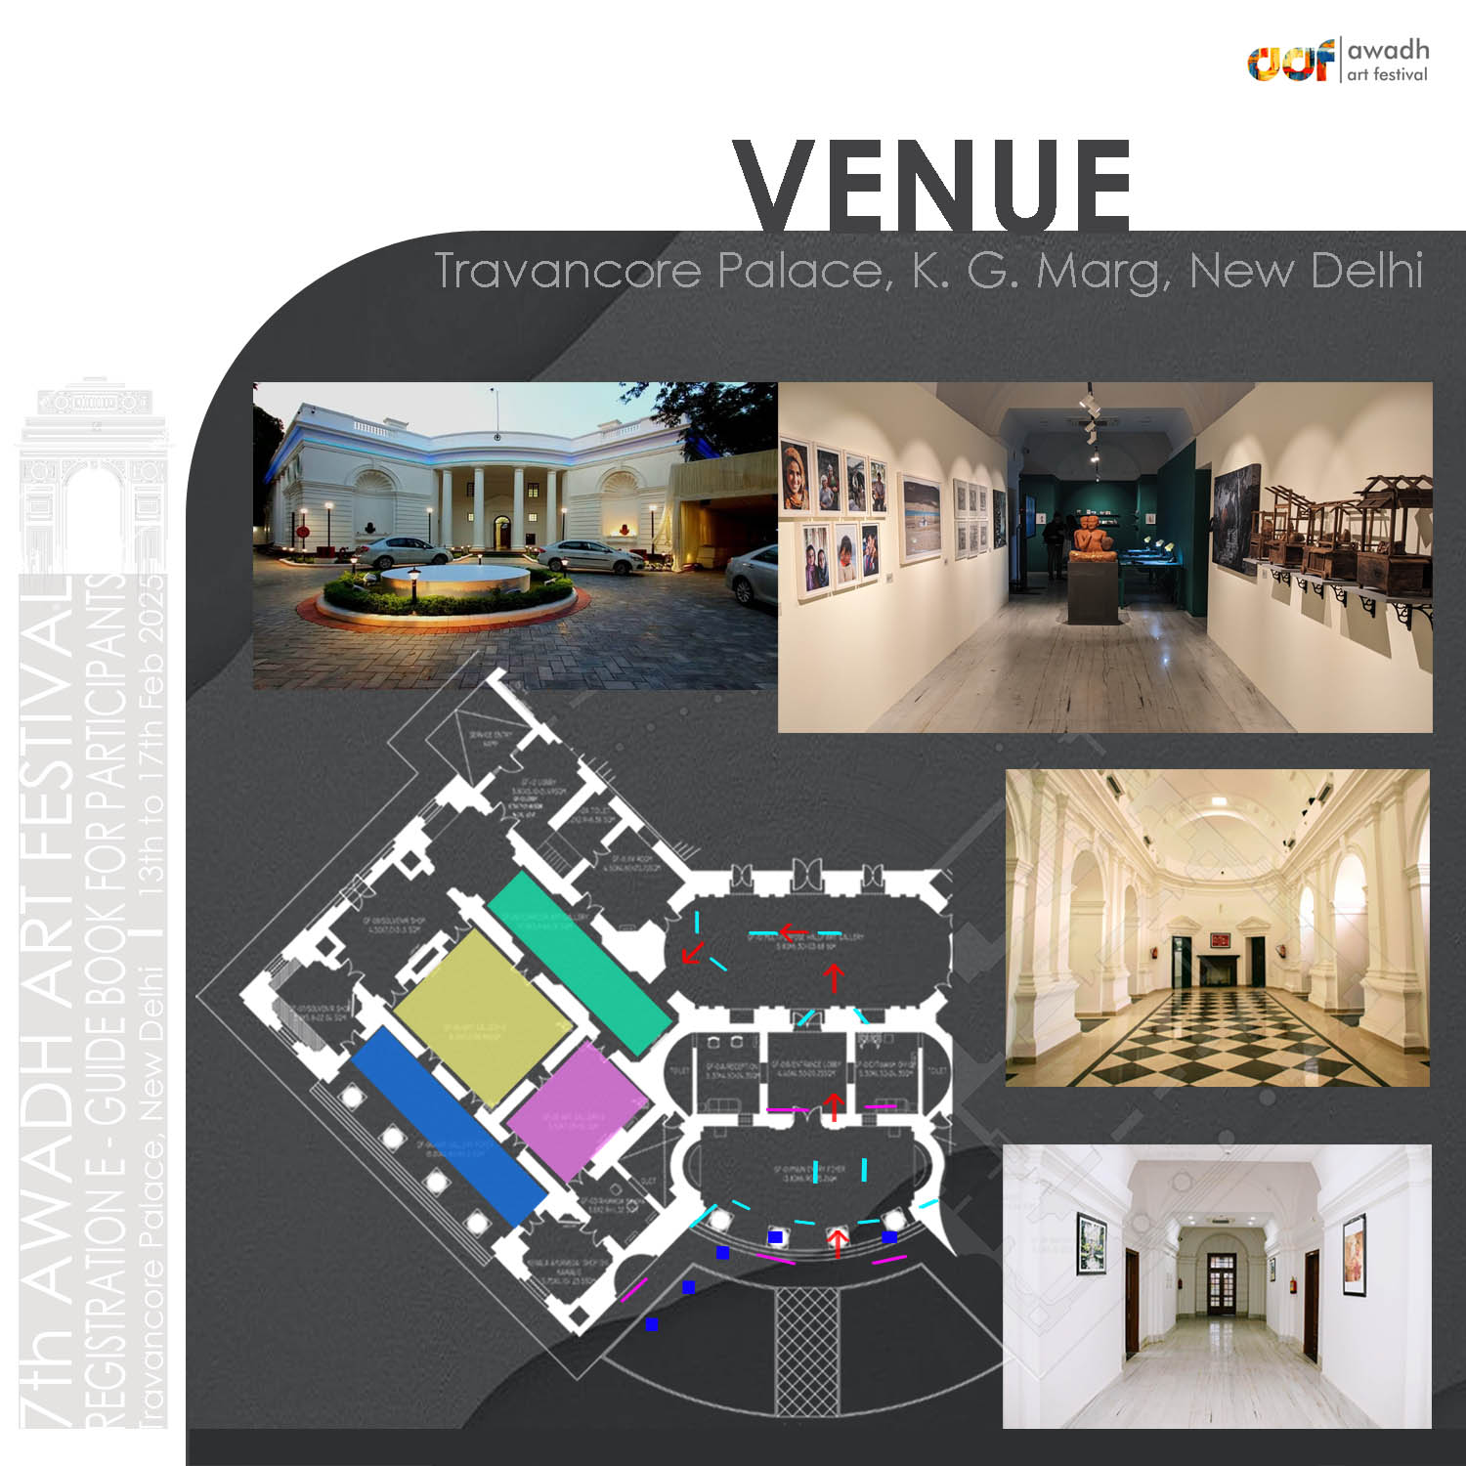

Slide 9


Slide 10


Slide 11


Slide 12

Art Colleges and Art Institutes
New Age Art Collectors
Hi Net Worth Individuals
Curators / Museum Representatives
Art Connoisseurs
Art Galleries
Embassies
Corporates Collectors
Cultural & Art Leaders
General Public
PSUs
Socialites

Slide 13
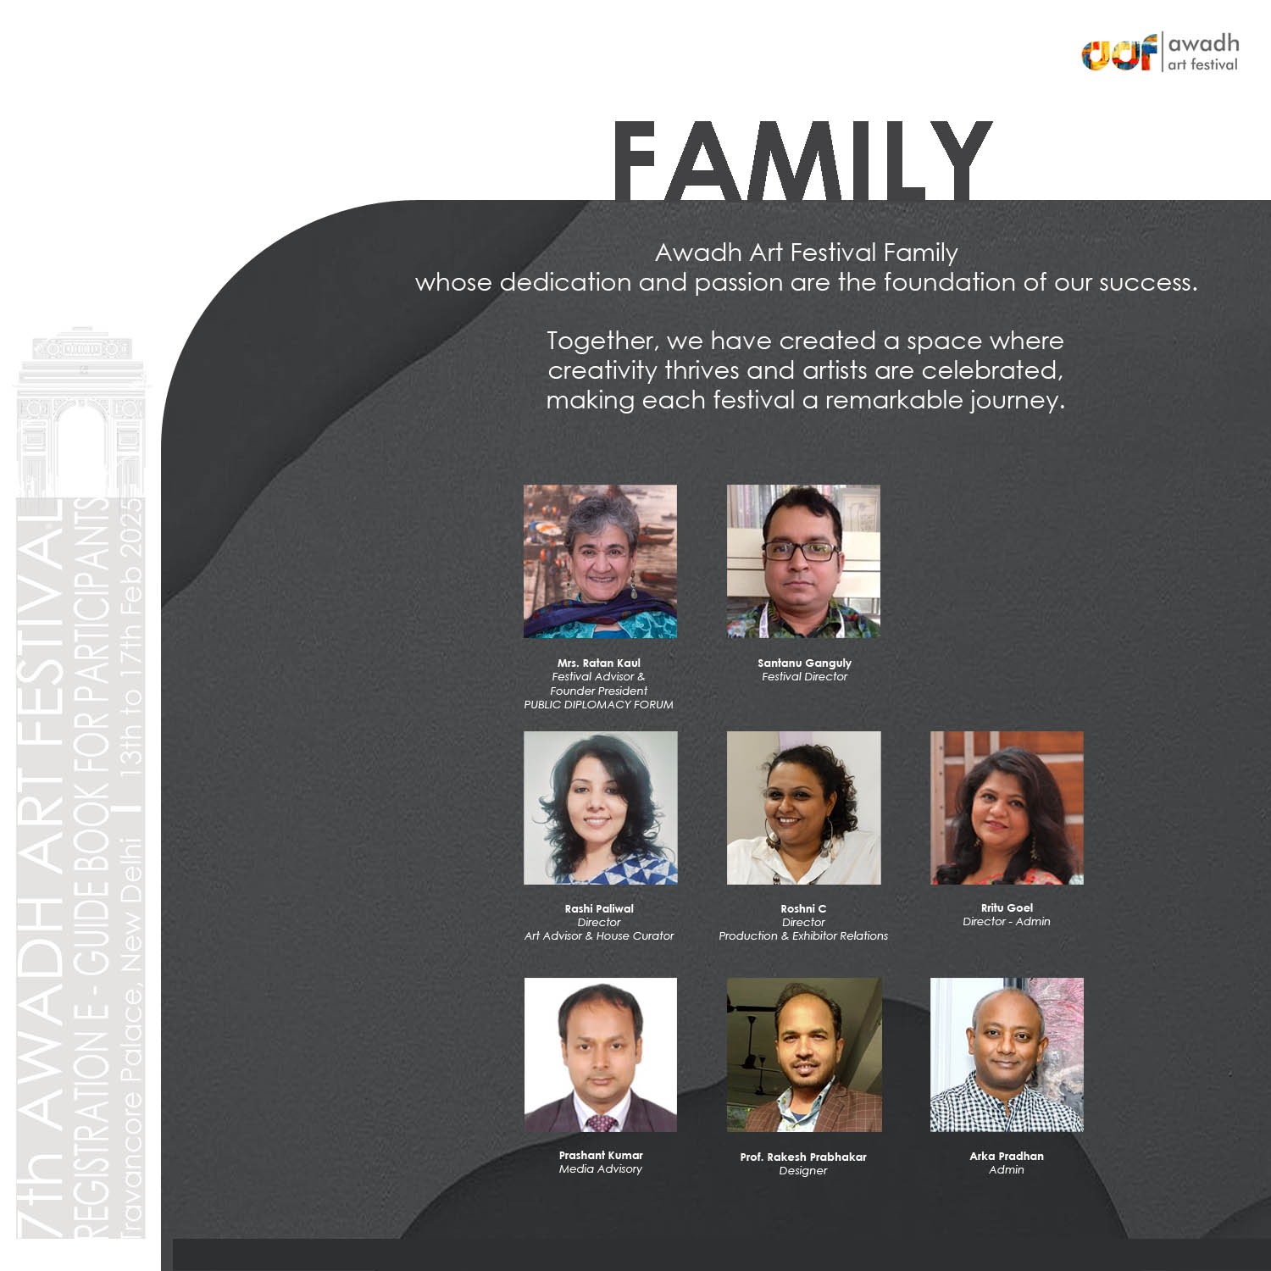

Slide 14

FOR ENQUIRY REGISTRATION +91 9833839951 (CALL OR WHATSAPP)

